Slide 1
SQL numeric functions are used primarily for numeric manipulation and/or mathematical calculations. Some of the numeric functions that we shall discuss are:
ABS ( )
CEIL ( )
FLOOR ( )
GREATEST ( )
LEAST ( )
MOD ( )
PI ( )
POWER ( )
ROUND ( )

Slide 2
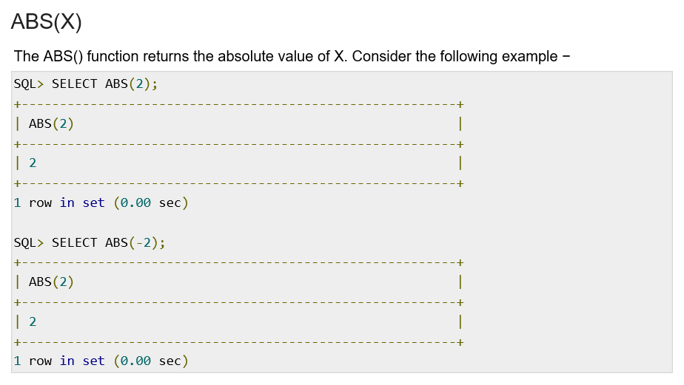
ABS ( )

Slide 3
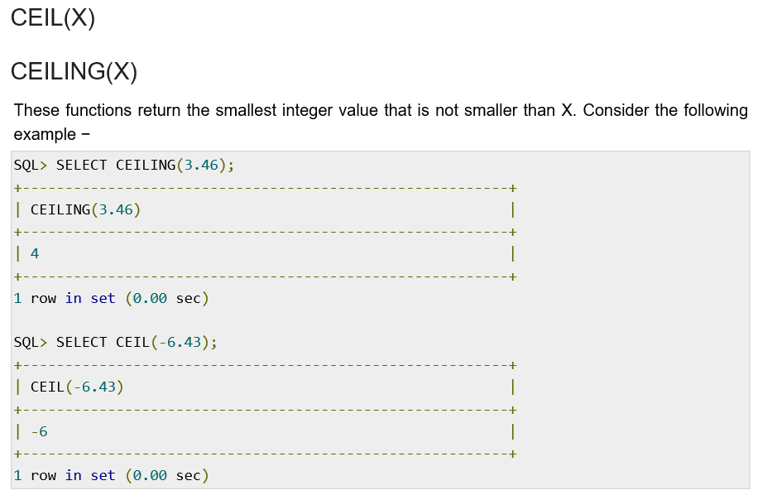
CEIL ( )

Slide 4
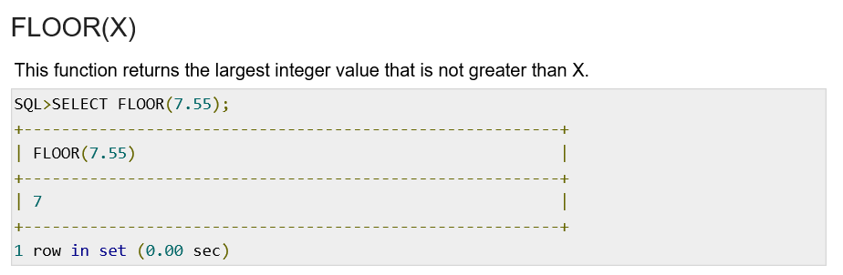
FLOOR ( )

Slide 5
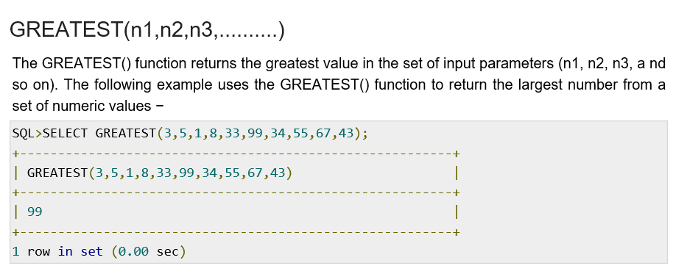
GREATEST ( )

Slide 6
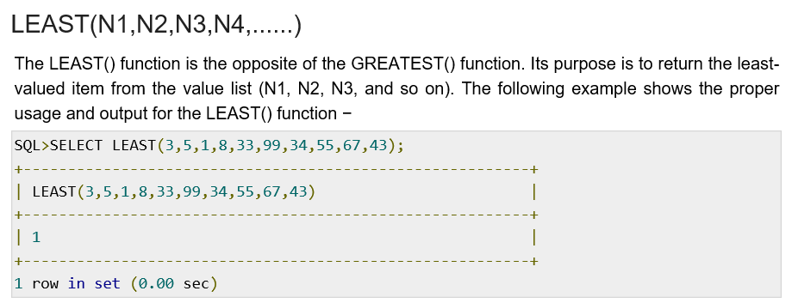
LEAST ( )

Slide 7
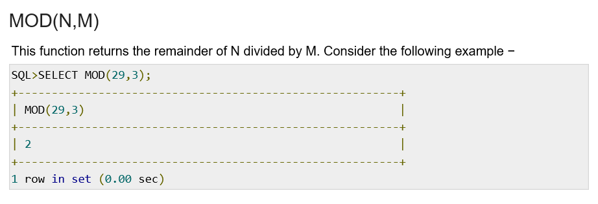
MOD ( )

Slide 8
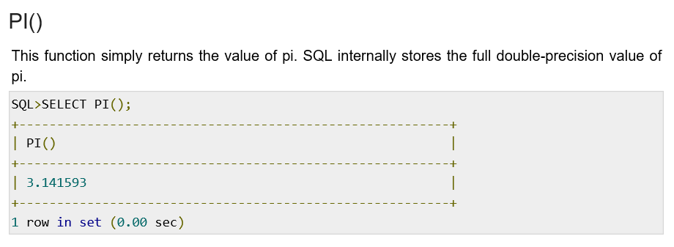
PI ( )

Slide 9
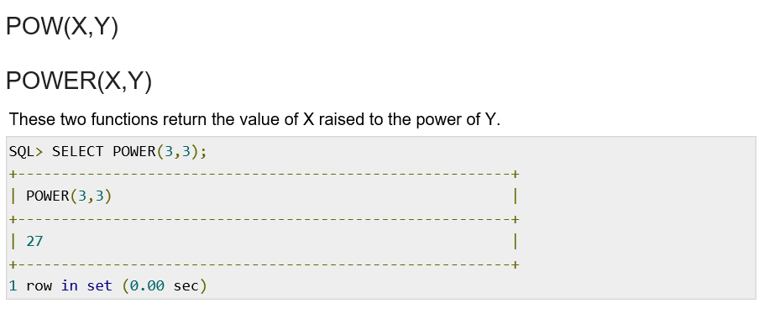
POWER ( )

Slide 10
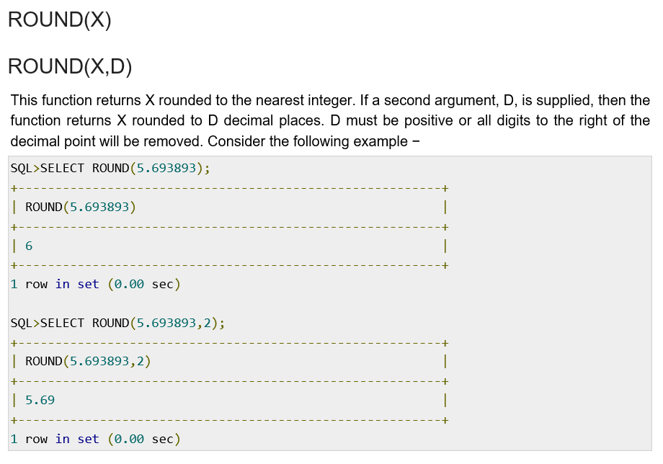
ROUND ( )

